Slide 1
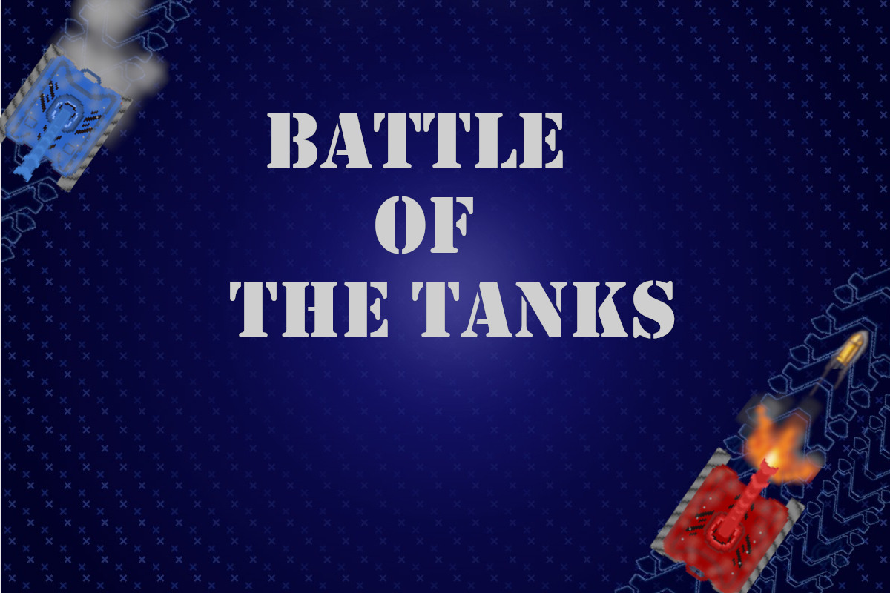
Team Members:
James Luciano Vlaicu-Matei Suba Charles Jacob Winkler The Vinh Vuong
Kiavash Emrani

Slide 2

Game Summary
In this game, you and your opponent will fight on 3 different battlefields using red and blue tanks.
Goal: eliminate the other player and win the rounds. To eliminate them, you must shoot the other player until he doesn't have any more lives left .
Another way a player can die is by hitting obstacles.
When someone dies, the map will change along with the obstacles. There will be medkits/heals that randomly spawn when you destroy and obstacle by shooting it. They heal for 1 heart once a player collects it

Slide 3
Game Summary part 2
The default shooting speed is 1 shot every 2 seconds.
Before the whole game starts, there will a 3 second splash screen with our names, the school logo and the course. After that, there will be a tutorial screen
It is a "best out of 3" game, so you need 2 points to win the game

Slide 4
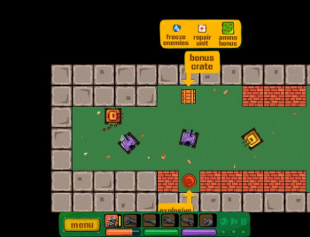
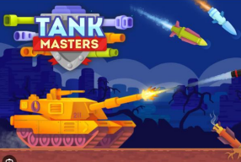
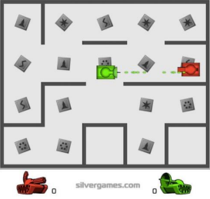
Related Games
Tank Trouble Tank Masters Awesome Tanks

Slide 5

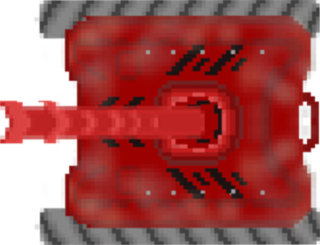
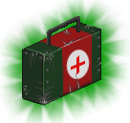
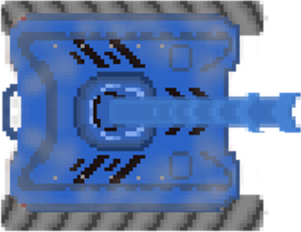
What Every World Has
The lives
Two tanks, one blue and one red
Medkits to heal
Scoring System

Slide 6
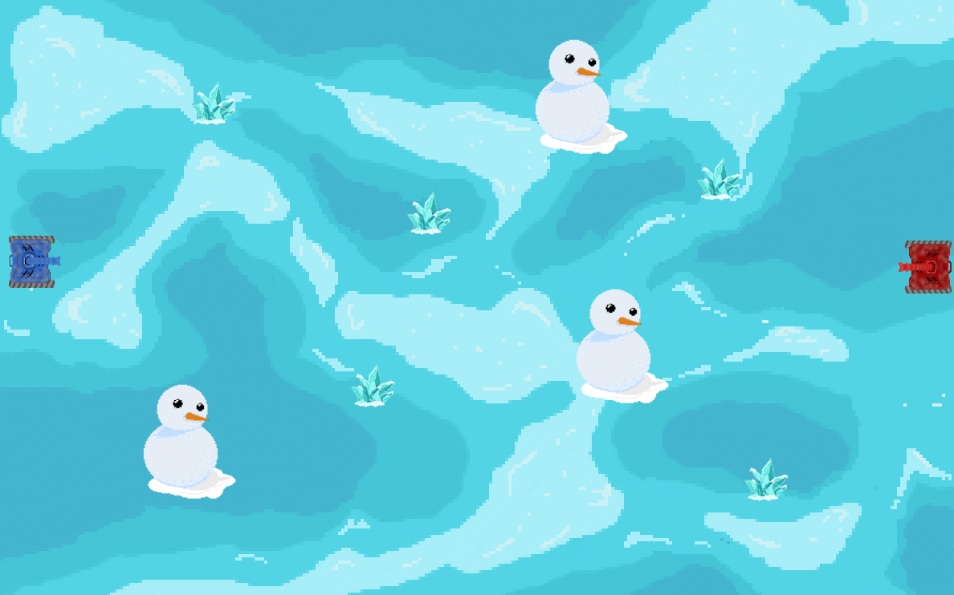


How the levels look like: Ice World

Slide 7
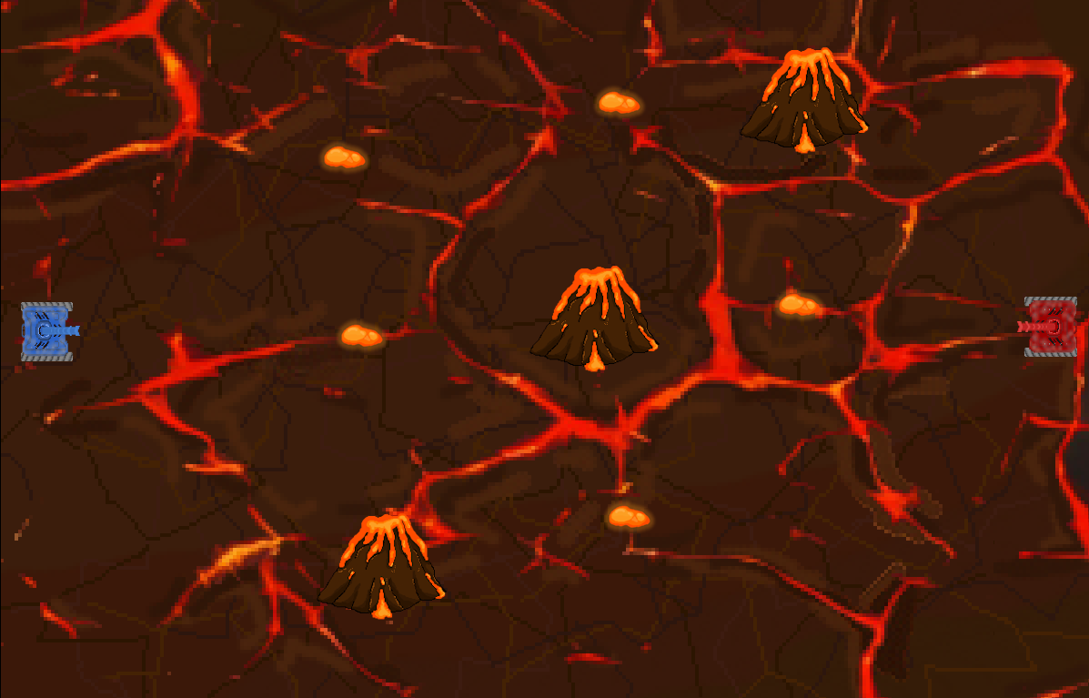
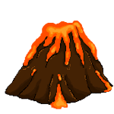

How the levels look like: Lava World

Slide 8
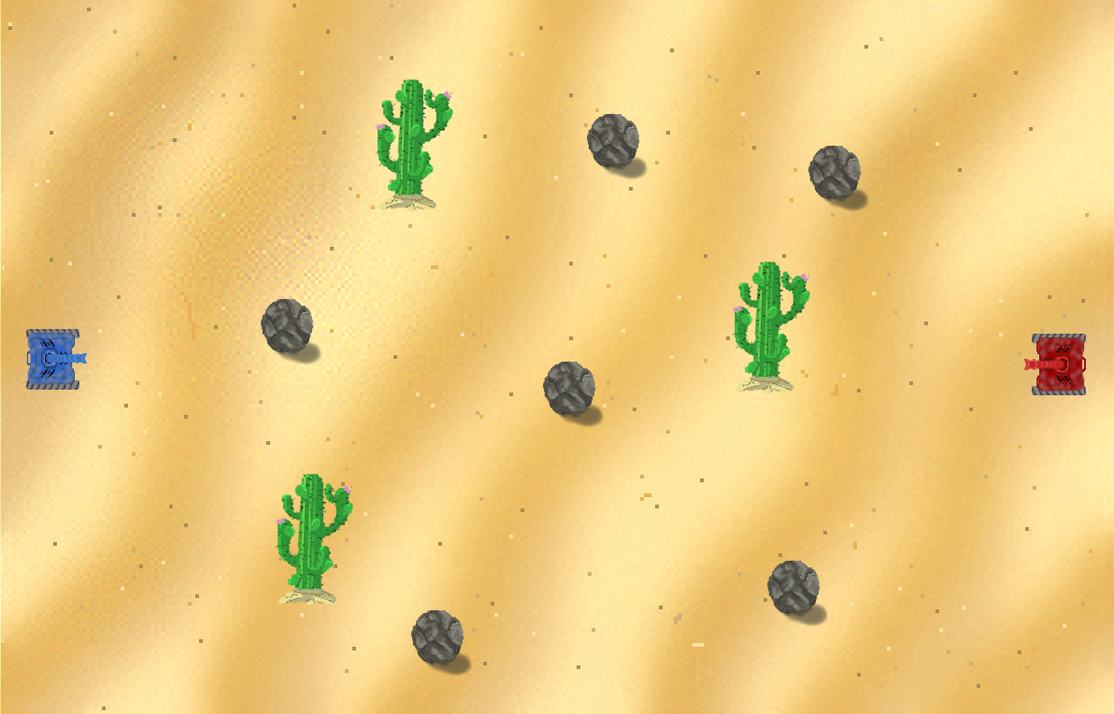

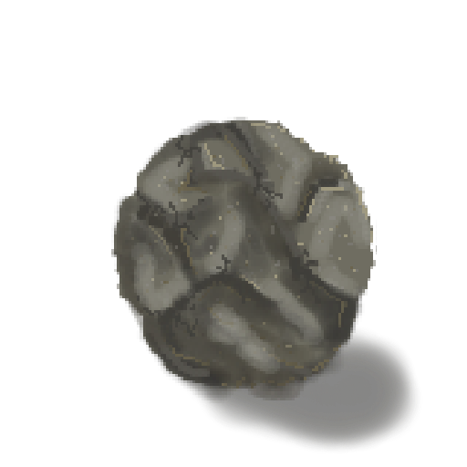
How the levels look like: Sand World

Slide 9
Controls
Blue Tank/Player 1 Red Tank/Player 2
W forward
A turn left
S backwards
D turn right
SPACE Shoot
I forward​
J turn left​
K backwards​
L turn right​
ENTER Shoot​

Slide 10
Main Contributions
Charles: Worked on main game functions (tanks moving, shooting, lives, obstacles, med kits), helped with transitions between intro screens and "controls" screen.
James: Gave ideas for obstacles/power ups/maps. Programmed basic mechanics (ex: movement), helped program shooting mechanics
Vlaicu: Drew the obstacles/ levels/ Players/ power ups. Coded the live heart changing system(visual), and tank moving animations
The Vinh: Found sounds, worked on the menu, gave ideas for images and heart system. Drew tutorial screen.
Kiavash: Worked on transitions, designed some splash screens and extra details

Slide 11
Struggles/Learnings
What went well:
Making the heart/lives system and everything surrounding it.
Animating the tanks and making the visuals (drawing maps, items, obstacles)
Creating basic mechanics (similar like the labs)
What went wrong:
Trying to code the bullet( there was some problems that were hard to figure out at first)
When one player would die, world wouldn't transition
Scoring system sometimes wouldn't work (players wouldn't lose lives)

Slide 12
Extra stuff we can add in the presentation
Images of splash screens/transitions
Scoring system
How the tutorial looks

